Slide 1

The NHS Project
LSE DATA ANALYTICS USING PYTHON

Slide 2
Introduction
This report is part of a wider mandate to help the NHS better understand why patients miss GP appointments. By understanding why patients miss appointments, the hope to reduce avoidable costs.
This report is focused on understanding capacity issues and resource utilization by identifying possible data trends.
Data: “actual_duration”, “appointment_regional”, “national_categories” and “tweets”.
Data collected between August 2021 and June 2022 from 106 locations across 5 different NHS services.

Slide 3
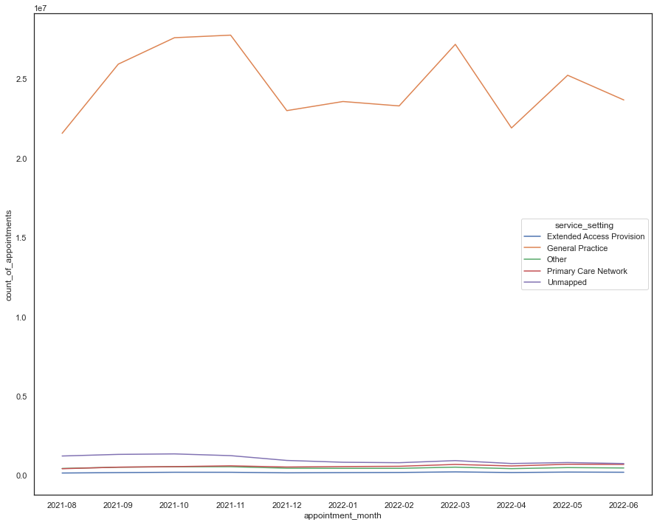
service trends

Slide 4
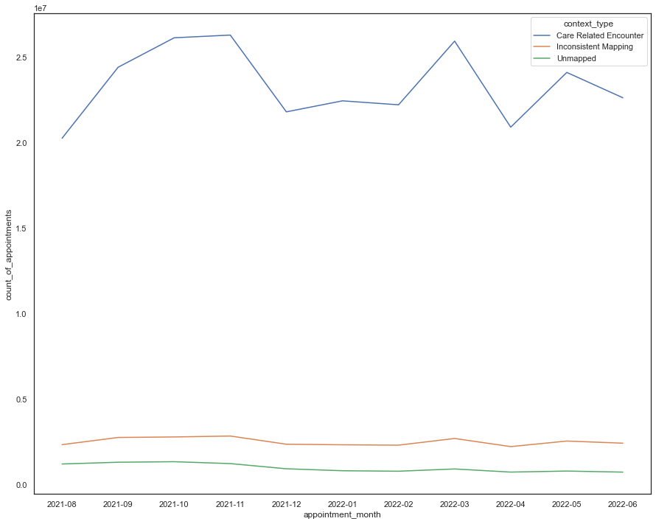
Context trends

Slide 5
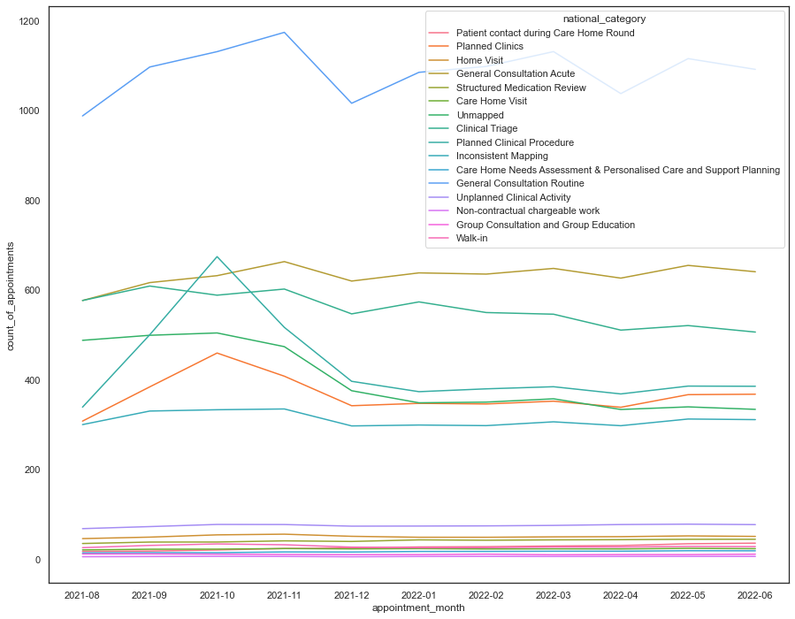
National category trends

Slide 6
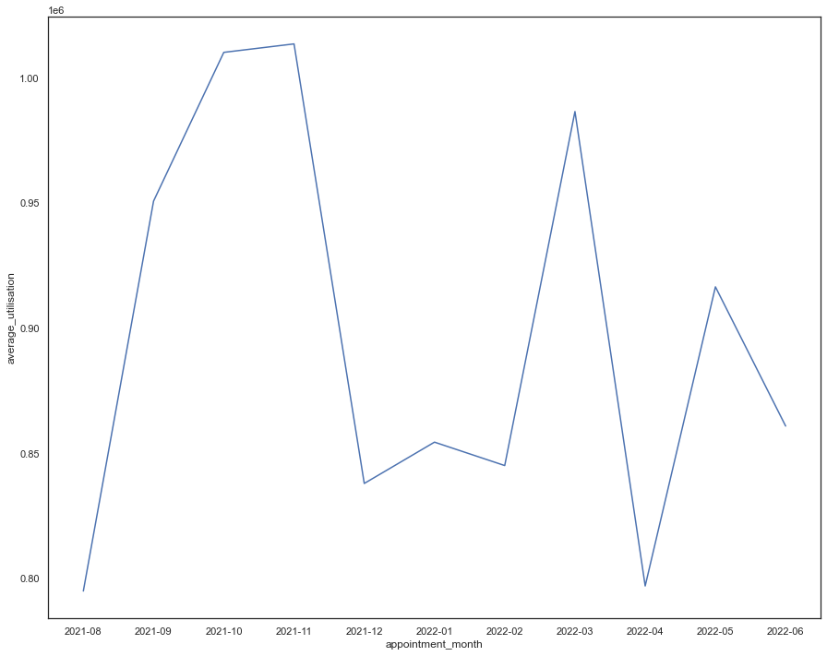
Monthly visits

Slide 7
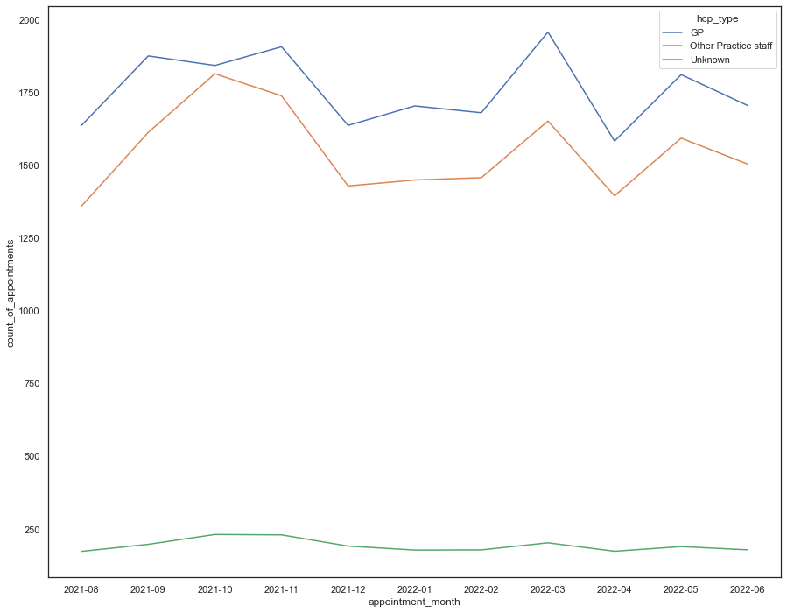
MONTHLY PRACTIONERS

Slide 8
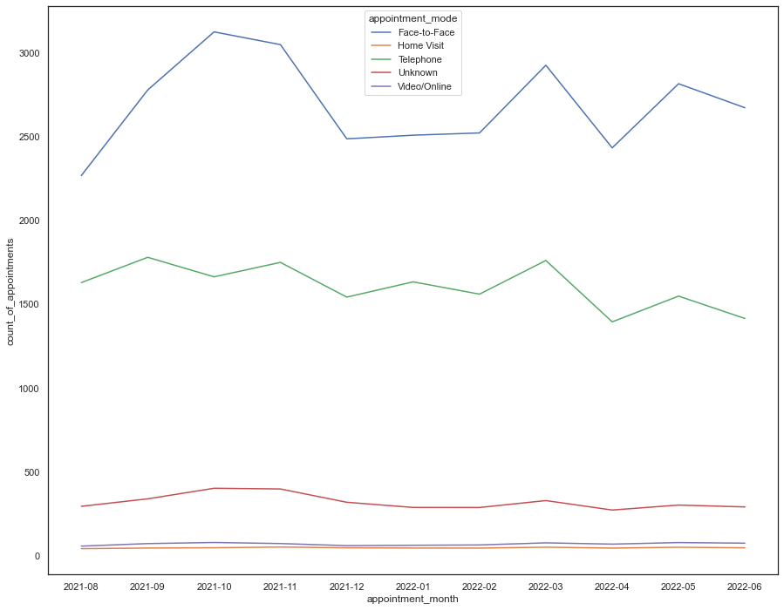
MONTHLY APPOINTMENS

Slide 9
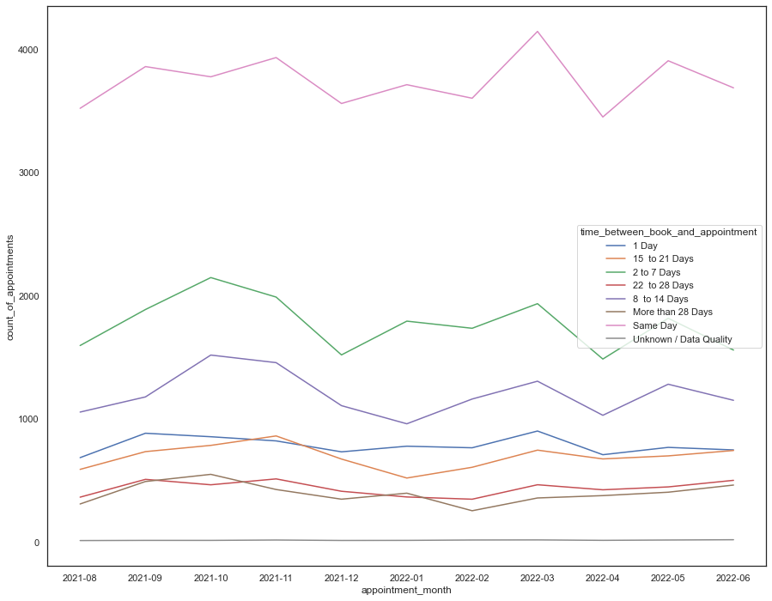
Appontment Booking timings

Slide 10
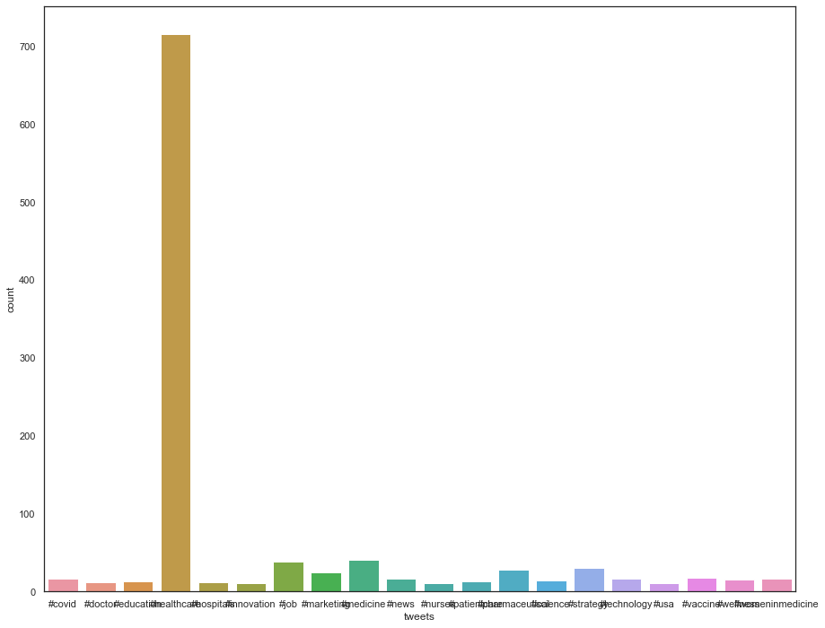
Popular tweets

Slide 11
RECOMENDATIONS
Focus on Capacity Issues and Resource Utilization in GP Space
Utilise Resources based on Seasonal Trends.
Further research required on lack of technology adoption.
Further research required to understand appoint scheduling issues
Twitter concerns should be prioritised.

